Slide 1
Natural language processing
Lecture 8: Language Generation I
Roberta Rocca
Assistant Professor, IMC & CHC
✉️ roberta.rocca@cas.au.dk
Notes:
TODO:
Why does repetition happen?
Fix slide 16

Slide 2
Exercise
What are keys, queries, and values? How are they used in the context of self-attention?
Which tasks is BERT trained on? What is the rationale behind the design/choice of these tasks?
Which of BERT’s outputs would you use for a token classification task? Which of BERT’s outputs would you use for a sequence classification task?
Notes:
Mention key, query, value

Slide 3
Recap: contextualized encodings
Throughout the course, we have reviewed methods that make it possible to represent language computationally
Last week, we introduced BERT: an encoder-only transformer architecture
BERT uses self-attention to yield dynamic/contextualized encodings of both individual tokens, and the full sequence
These representations are sensitive to order thanks to positional embeddings
The Holy Grail!
Notes:
Both intelligence

Slide 4
Recap: transfer learning
BERT is “pretrained” on large volumes of text using two objectives: masked language modeling (a form of language modeling) and next sentence prediction
While previously we would train one neural network architecture for each downstream task, with BERT(-like models) we do something smarter
We can perform pretty much any task by making minimal changes to a trained BERT (e.g., appending a classification module after the outputs)
We then simply fine-tune the model on our target task
This approach is known as transfer learning
Notes:
Both intelligence

Slide 5
Today’s plan
Transfer learning
Language models as generative models
Solving any tasks as a text-to-text task (T5)
Learning without fine-tuning with generative models (GPT-3)
Notes:
Both intelligence

Slide 6
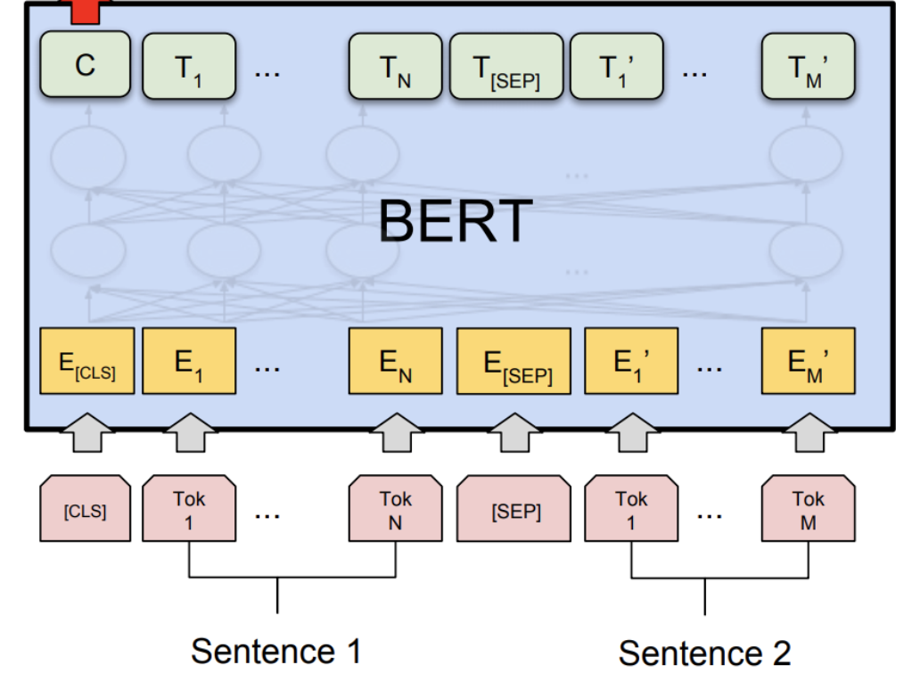
Notes:
Both intelligence

Slide 7
Transfer learning with BERT
Through MLM and NSP pretraining BERT learns two things
Contextualized token-level representations
Sequence-level representations ([CLS])
So far, our approach to using language to perform downstream tasks (e.g., sequence classification) has been to use a model (e.g., Word2Vec) to extract encodings, then feed them to a new architecture
With BERT, we can swap the head (all layers above the transformer encoder output), introduce a new layer that fits our target task, and keep training the same architecture (potentially freezing some layers)
Notes:
Transformers have

Slide 8
Transfer learning with BERT
Our pretrained architecture already encodes a lot of useful information on language/meaning! It is just a matter of adapting it a bit to the new task (fine-tuning)
This approach, called transfer learning (and made possible with libraries for open-source sharing of pretrained models, such as HuggingFace’s libraries), outperforms by orders of magnitude all previous architectures on pretty much all downstream NLP tasks
This has made transformer ubiquitous in NLP
Notes:
Transformers have

Slide 9
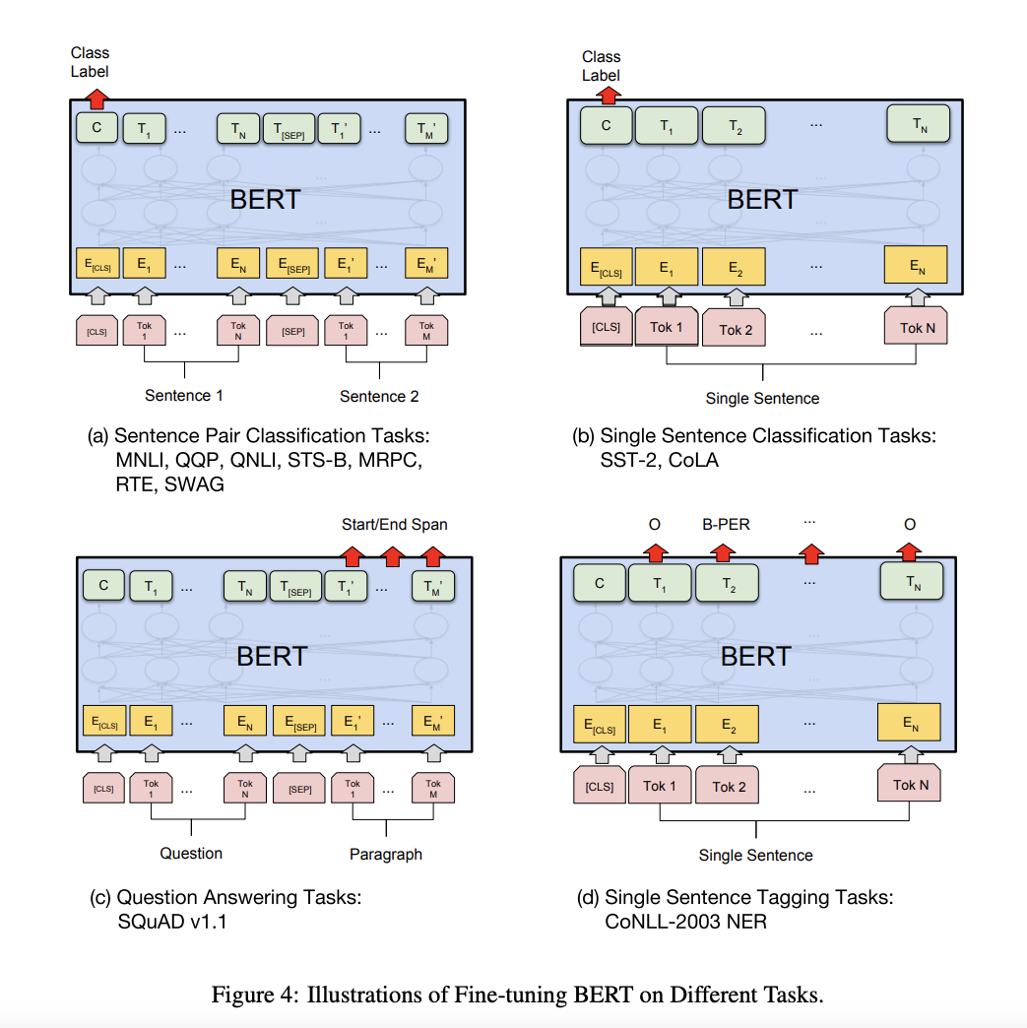
Fine tuning on NLP tasks
Sentence Pair Classification tasks
Linear + Softmax layer on top of the CLS output
Single Sentence Classification Task
Same
Question Answering Tasks
Given a question and a paragraph in which the answer lies. The objective is to determine the start and end span for the answer in the paragraph.
See also text summarization
Single Sentence Tagging Task
POS tagging, NER, etc. We just add a Linear layer of size (768 x n_outputs) and a softmax layer on top to predict

Slide 10
BERT as a black box
BERT did really, really well in a lot of tasks that previous models could not solve optimally
But what is happening inside BERT? What does BERT really learn through pretraining? How do its attention mechanisms really work? Do we need all of them? And is BERT biased?
Is BERT learning anything general about semantics/syntax, or is it just a very sophisticated parrot?
Since the introduction of BERT, people have been trying to devise smart ways to “open the black box” and probe BERT’s internal mechanisms and knowledge
This literature is known as “BERTology”
Notes:
Machine translation is not trivial

Slide 11
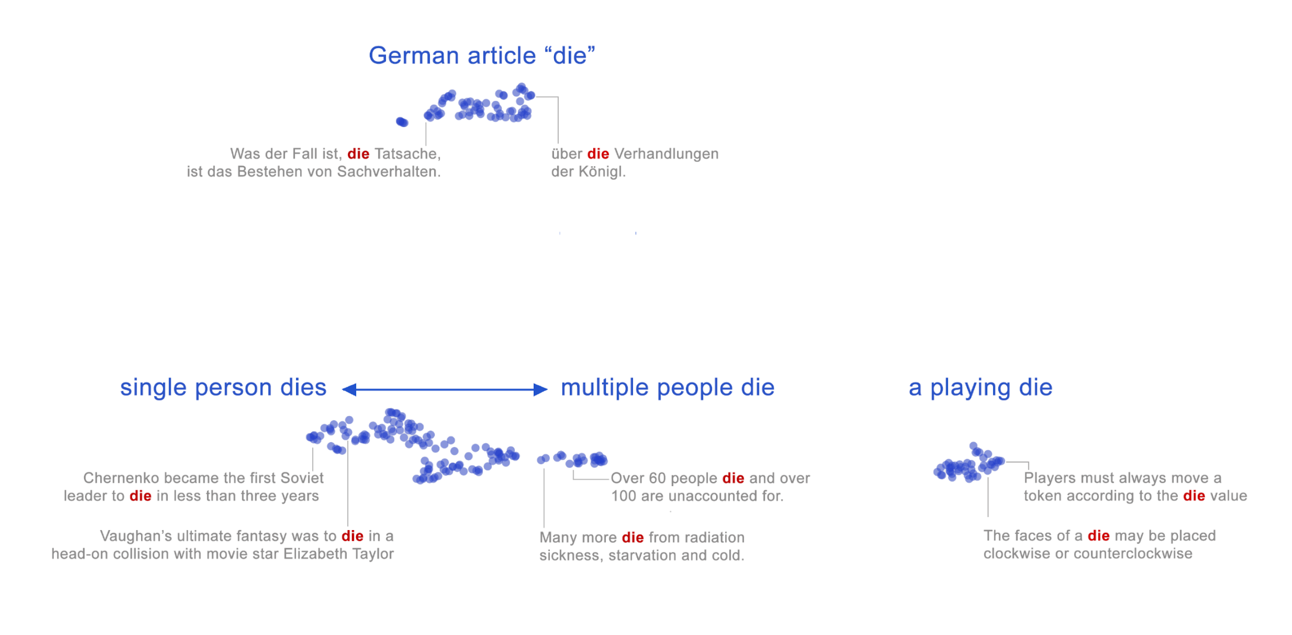
An example: contextualised embeddings
[Something we could not do with static embeddings, e.g., word2vec]
https://storage.googleapis.com/bert-wsd-vis/demo/index.html?#word=die
Coenen et al. (2019), Visualizing and Measuring the Geometry of BERT

Slide 12
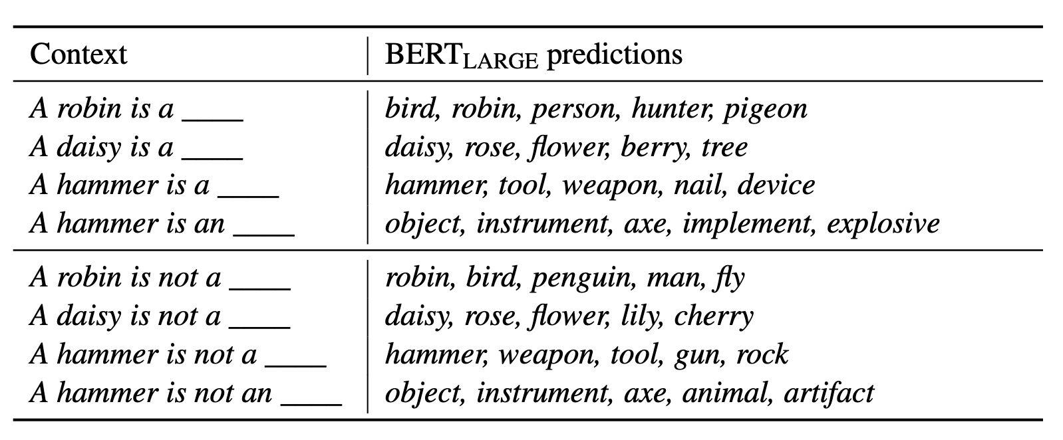
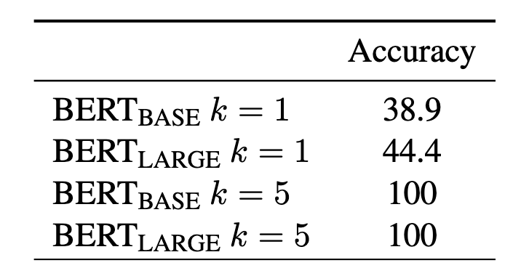
Psycholinguistics tasks
Ettinger (2019) devised a series of diagnostic tests in order to see what specific linguistics capacities are learned by language models
These tests allow us to ask specific targeted questions about information used by LMs for generating predictions in context
Common-sense and pragmatic inference
Event knowledge and semantic roles
Negation

Slide 13
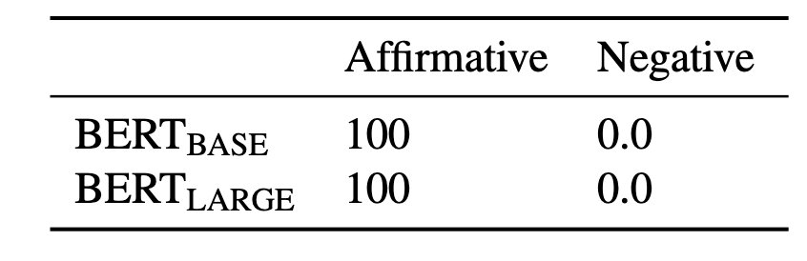
Psycholinguistics tasks
BERT shows strong insensitivity to the meaning of negation, with preferring the category match every time

Slide 14
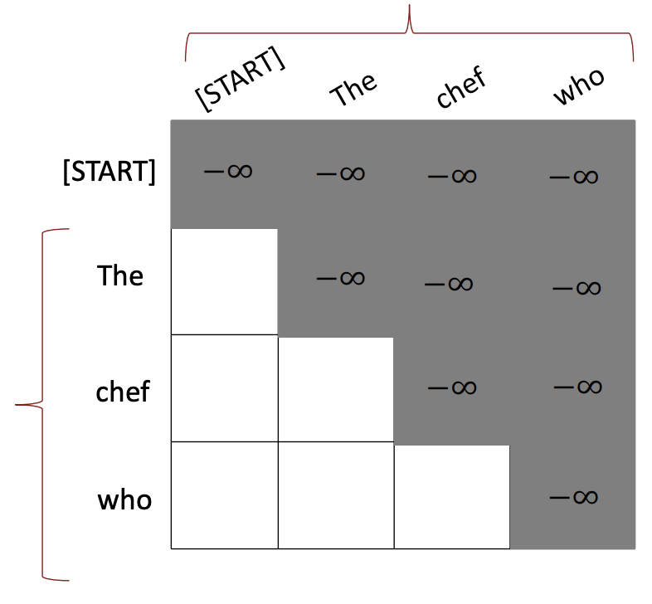
From masked language modeling to forward language modeling
BERT is trained on masked language modeling, but we can adapt attention to performing forward (or “autoregressive”) language modeling
Given a sequence, predict the next word in a sequence
To do so, we adapt our attention mechanism so that only preceding words are taken into consideration when computing attention weights

Slide 15
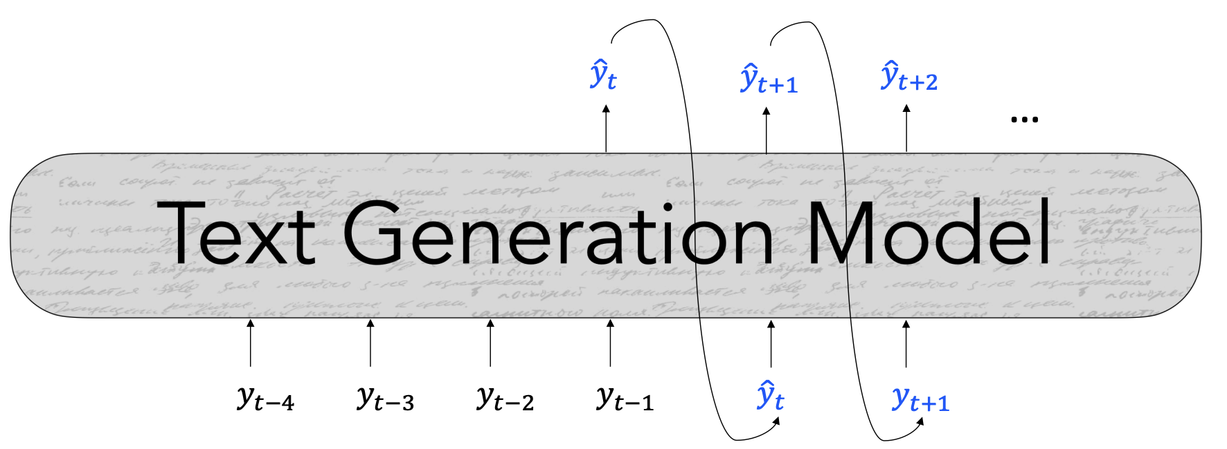
Generating sequences with language models
With this type of attention, we can train a transformer to produce plausible predictions for the next word
A model trained on LM can be used to predict plausible next words (i.e., generate), if we sample from its predicted probabilities
… we can append the currently generated words to the input, to keep generating new words …

Slide 16
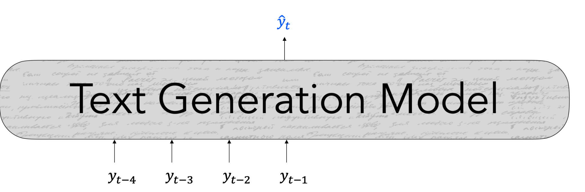
Let’s look at a single step
For a given token t, the model produces a contextualized representation of t using self-attention
This encoding is passed to a classification layer, i.e., a feed-forward layer that takes the encoding as input, and outputs a number of values = the vocabulary of our model
These values are passed through a softmax function, to obtain a probability distribution
The probability distribution represents the probability that each token in the vocabulary is the next word

Slide 17
Single step: training time
At training, we use these predictions and the true words (i.e., the actual next word) to compute the loss
We use the loss to update the model via gradient descent
Then we move on to the next step, trying to predict y_{t+1} from y_{1:t}
If we allow for sequences of different length, we can do this in parallel on a full sequence
Teacher forcing: we use tokens from our “true” text as model input at training, rather than using model predictions

Slide 18
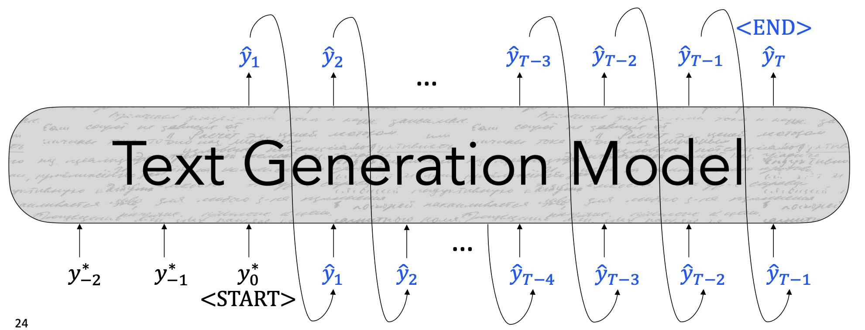
Single step: inference time
Now let’s assume we want to use this trained model to generate text (e.g., complete a sentence)
At inference (i.e., when we just want to use a trained model for a given task), we want to use the probability distribution the model produces to find a next word, which we then feed to the model as input
Q: what do we do?

Slide 19
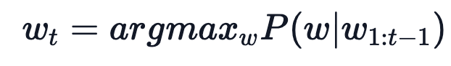
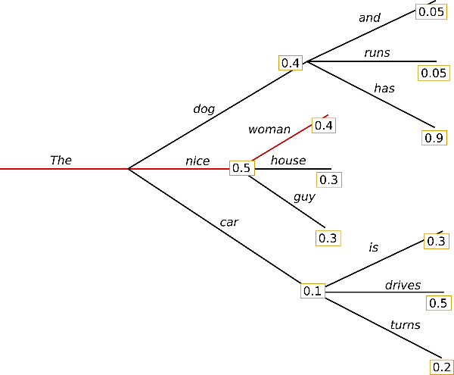
Decoding strategies
The process of “extracting” the next word from a probability distribution is called decoding (note: this is only relevant for inference)
The simplest option is to select the word with the highest probability
This approach is called greedy decoding
Q: Very simple but can you see any disadvantages?
https://huggingface.co/blog/how-to-generate

Slide 20
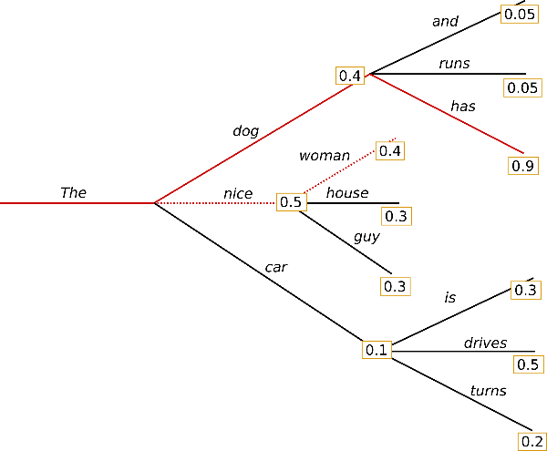
Decoding strategies
Greedy search misses high-probability sequences
Another “greedy” approach is beam search: the algorithm keeps several options “active” at the same time
E.g., a beam search with n=2 keeps the two most likely sequences “active” at each time step
This is based on the joint probability of the generated sequence
https://huggingface.co/blog/how-to-generate

Slide 21
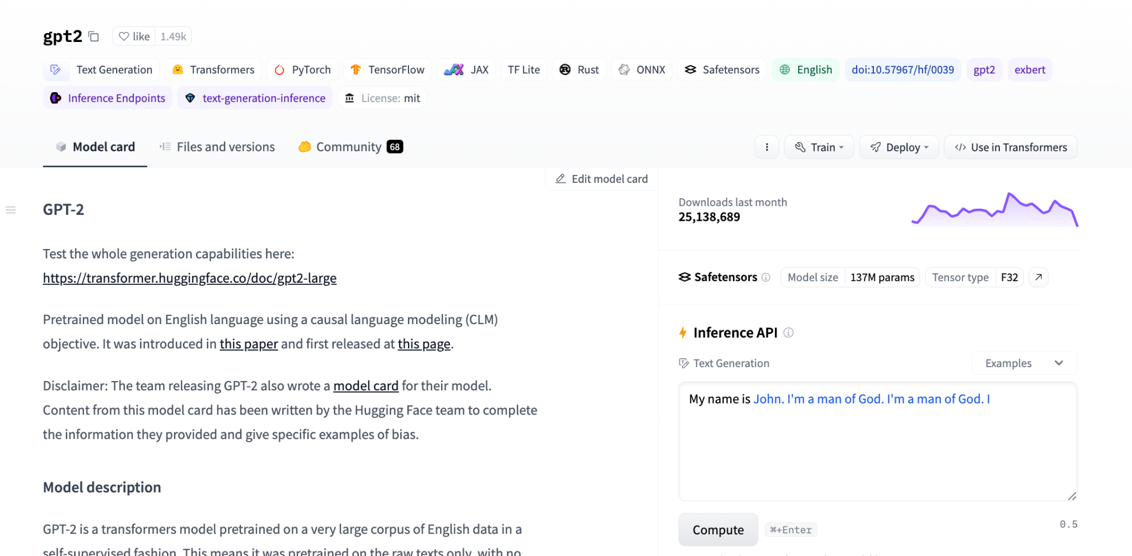
Decoding strategies

Slide 22
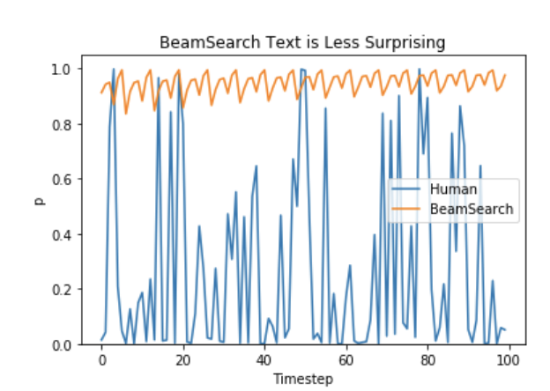
Decoding strategies
The output of greedy decoding strategies tends to be highly repetitive
The output of greedy decoding strategies also tends to be too predictable, compared to human text
This can be improved by sampling from the model’s probability distribution
https://huggingface.co/blog/how-to-generate

Slide 23
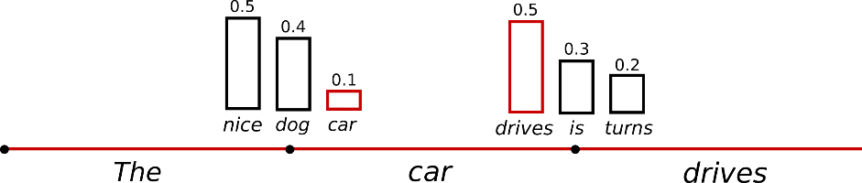
Decoding through sampling
In its simplest form, this implies sampling from the raw probability distribution: words with higher probabilities are more likely to be selected.
Q: Potential issues with this approach?
https://huggingface.co/blog/how-to-generate
Notes:
Very inadequate words!

Slide 24
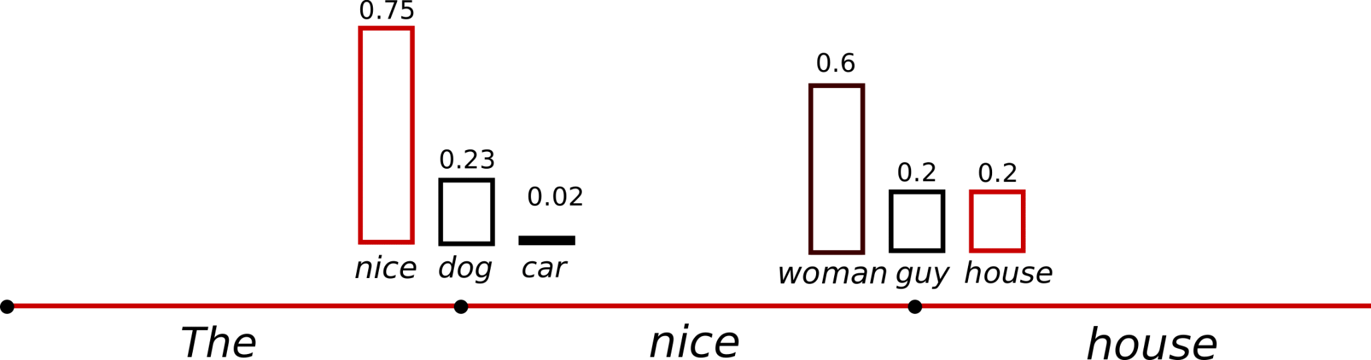
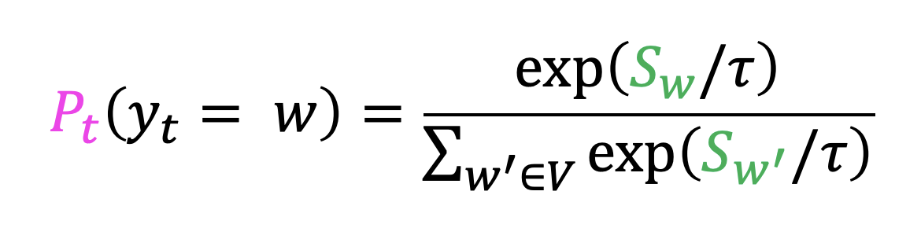
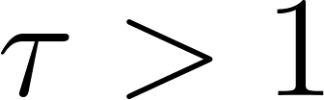
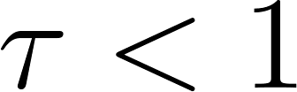
Decoding through sampling: temperature scaling
Before doing so, the probability distribution can be modulated by applying temperature scaling, where temperature is simply a parameter added to the softmax transformation to make a distribution more “uniform” or “spikier”
If , the distribution becomes more uniform. If , the distribution gets spikier
https://huggingface.co/blog/how-to-generate

Slide 25
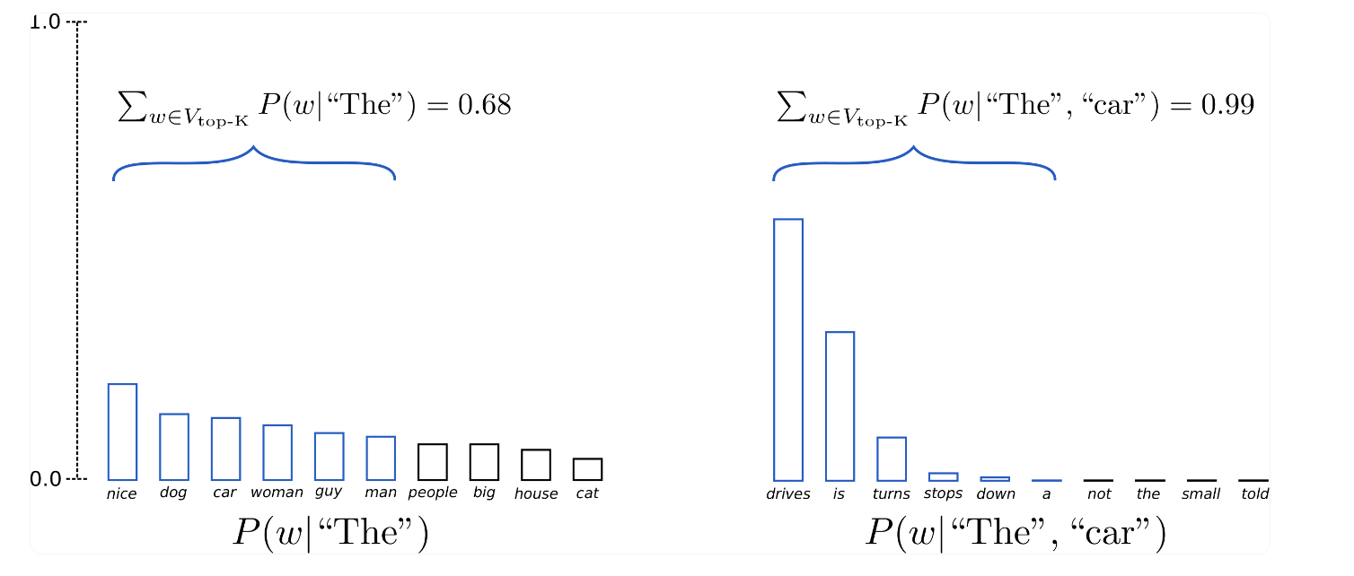
Decoding through sampling: top-k sampling
Top-k sampling: sample only from the top-k words in the distribution to avoid really implausible candidate. The probability mass is redistributed among the top-k words.
https://huggingface.co/blog/how-to-generate

Slide 26
Decoding through sampling: top-k sampling
Issues: Top-k sampling may both mask plausible candidates (if the mass is very evenly distributed) or still include very implausible candidates (if the mass is unevenly distributed)
https://huggingface.co/blog/how-to-generate

Slide 27
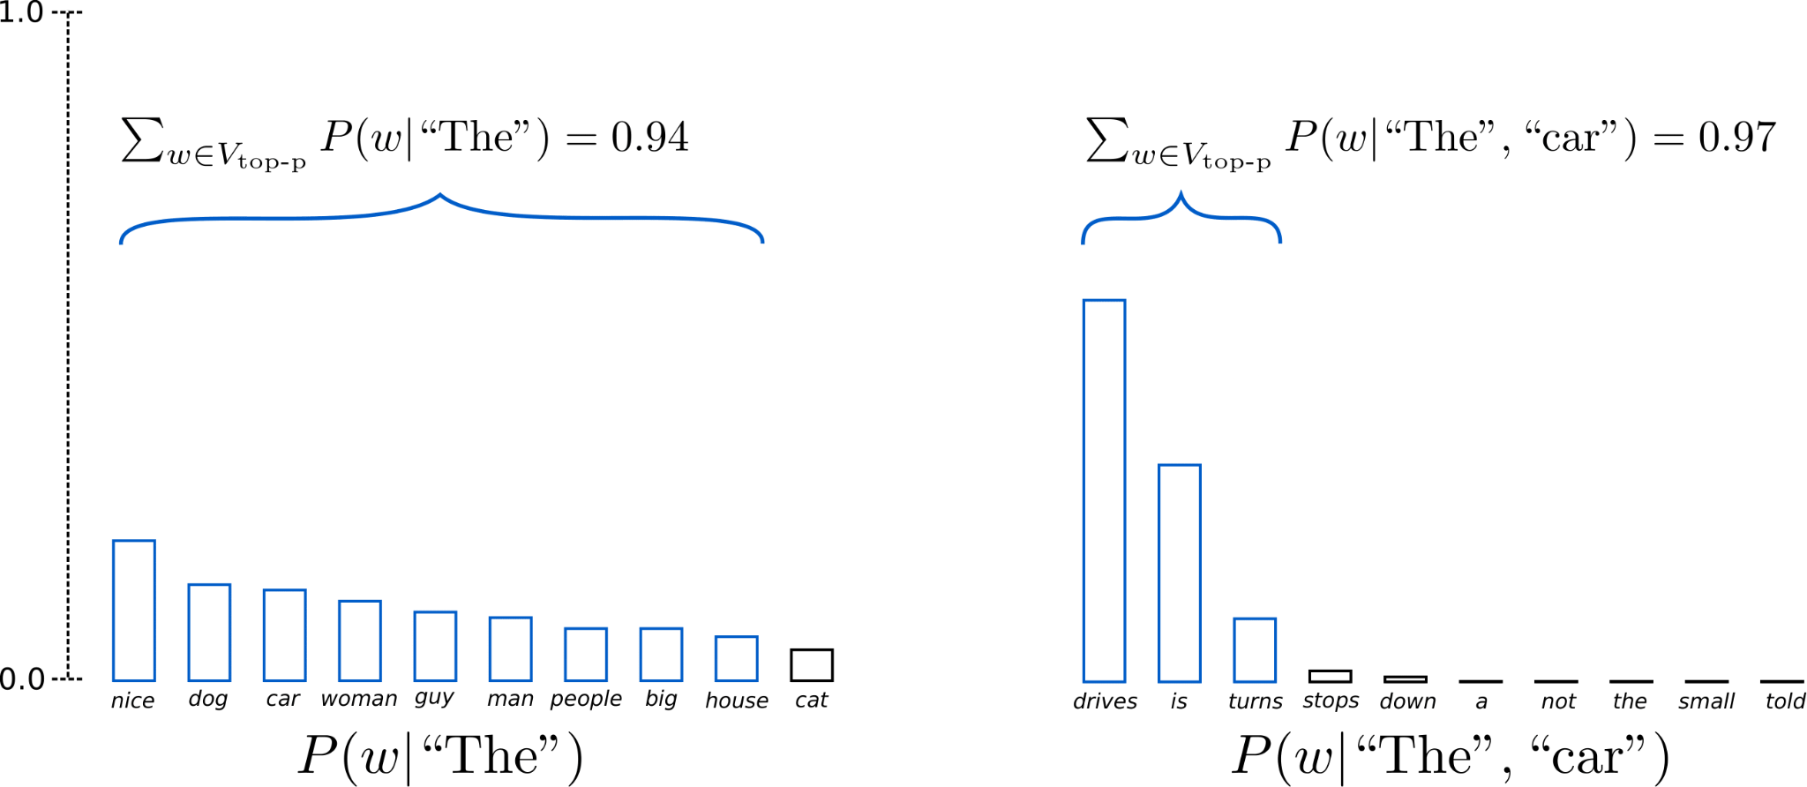
Decoding through sampling: top-p sampling
Top-p sampling: sample from the smallest set of words whose probability mass is higher than a given threshold. This dynamically adjusts the number of words we can sample from, and it ensures that it is fairly plausible candidate words. E.g., if we set p = 0.92:
https://huggingface.co/blog/how-to-generate

Slide 28
Decoding through sampling: top-p sampling
Note: some of these approaches can also be combined: you can sample multiple times and combine sampling with beam search
https://huggingface.co/blog/how-to-generate

Slide 29
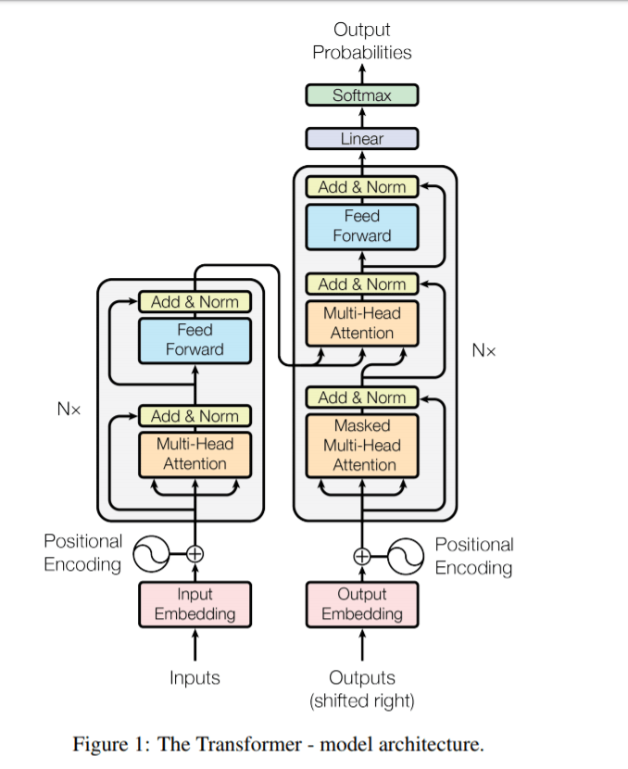
Generative Pretrained Transformers
GPT is a transformer architecture trained on autoregressive language modeling by applying unidirectional attention
It is a model that is natively suited to doing language generation
GPT is a decoder-only architecture, similar to the decoder in the original transformer, just with no cross attention (the main architectural difference with BERT is the unidirectional attention)
GPT-4 is the most recent architecture, but the main differences between GPT releases concern scale

Slide 30
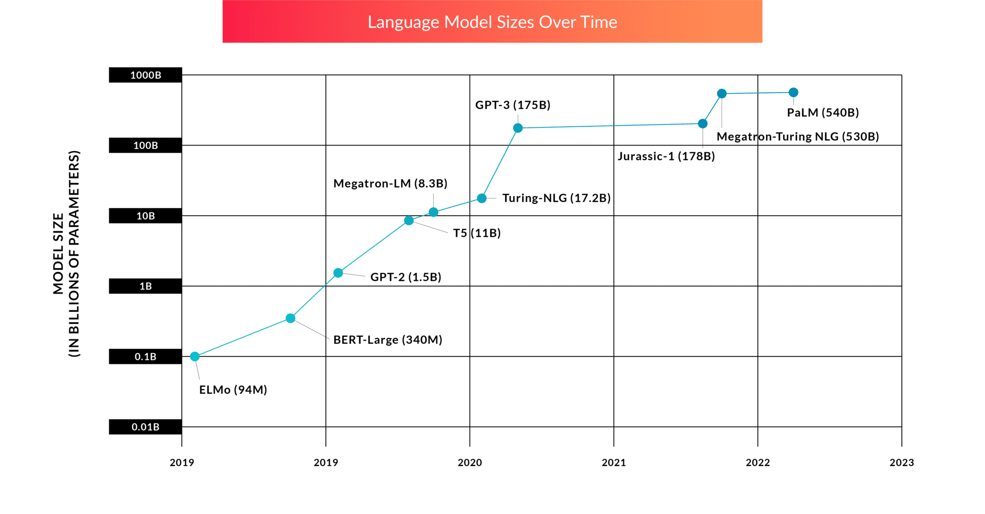
Notes:
1 trillion

Slide 31
Break

Slide 32
Natural language generation
Natural language generation (NLG) is the process underlying any task that requires producing text using a computational model
Notes:
Working definition so far

Slide 33
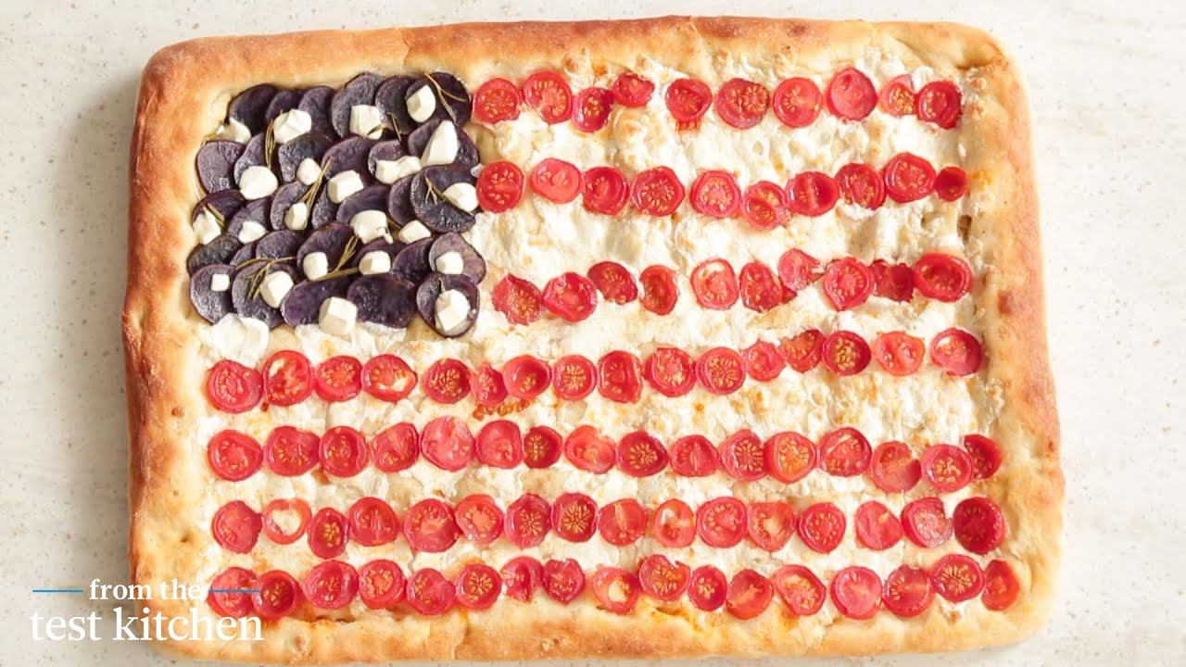

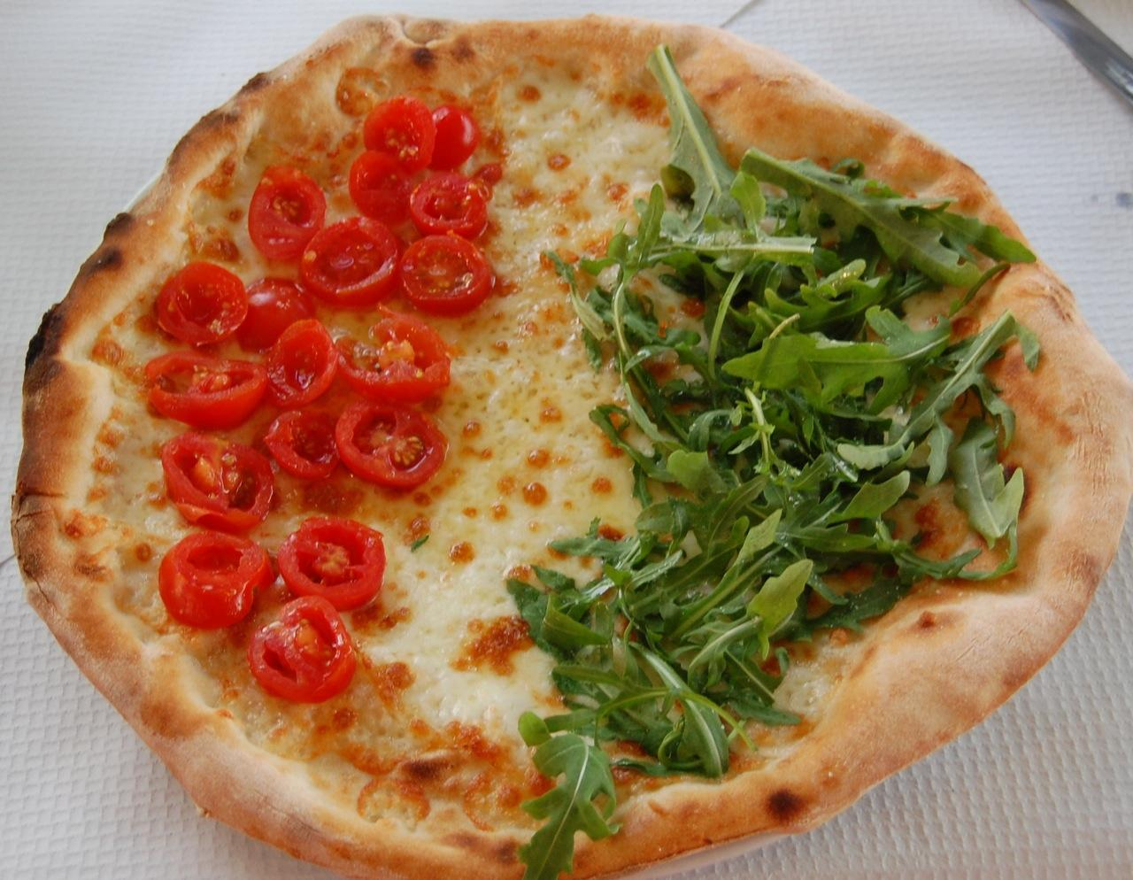
Natural language generation
Natural language generation (NLG) is the process underlying any task that requires producing text using a computational model
Machine translation
“I love pizza”
“Adoro la pizza”
Notes:
Working definition so far

Slide 34
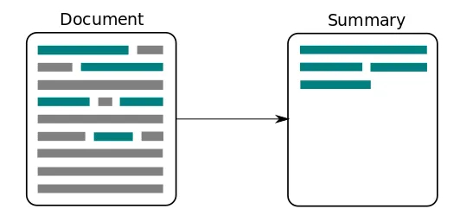
Natural language generation
Natural language generation (NLG) is the process underlying any task that requires producing text using a computational model
Text summarization
Notes:
Working definition so far

Slide 35
Natural language generation
Natural language generation (NLG) is the process underlying any task that requires producing text using a computational model
Story generation
It was a dark and stormy night; the rain fell in torrents — except at occasional intervals, when it was checked by a violent gust of wind which swept up the streets (for it is in London that our scene lies), rattling along the housetops, and fiercely agitating the scanty flame of the lamps that struggled against the darkness.
It was a dark and stormy night…
Notes:
Working definition so far

Slide 36
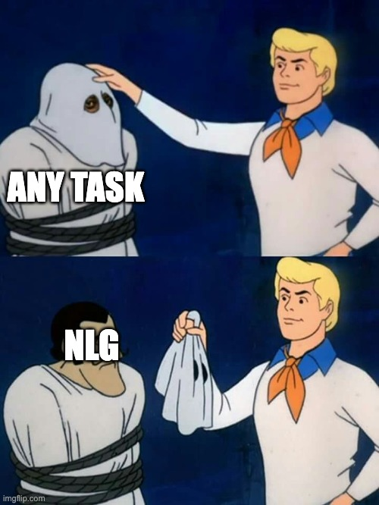
Natural language generation
From an NLP perspective, the really cool thing here is this
Even tasks which we have considered “numerical” supervised tasks can be reframed as language generation tasks
E.g., you can look at sentiment classification as the task of generating a correct label (e.g., positive) in response to a sequence
This does not just apply to classification tasks, but to any task
Notes:
Working definition so far – we tend to think that producing text is a human thing

Slide 37
Adapting language modeling to NLG tasks
Some of the tasks we have looked at can be solved directly (at least in principle) by simply applying the kind of language modeling architecture we have discussed before
One example is story generation/completion: we just feed the input and ask the model to continue it by iteratively producing words
But how about machine translation? Summarization? Question answering? How do we solve them using a language modeling architecture like GPT?
Notes:
Working definition so far

Slide 38
A unified text-to-text approach to NLG
All these tasks are sequence-to-sequence tasks: generating an output sequence based on an input sequence
Only the “meta” aspects of each task vary: the way the input and output sentences relate to each other is what makes tasks different
But tasks themselves can be described as … language!
All tasks can be converted to the same format: a text-to-text task, where the input includes a prompt or instruction on what the model should do with that specific input
All the model needs to do is learn to generate the output sequence, one word at a time, based on the input it receives!
Notes:
Working definition so far

Slide 39
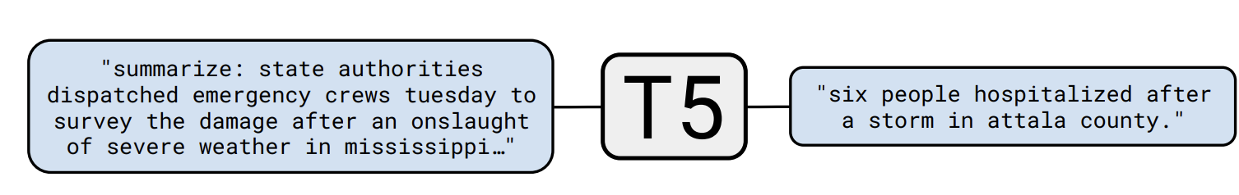
What does this mean in practice?
process & generate next words
Language Model
Notes:
Working definition so far

Slide 40
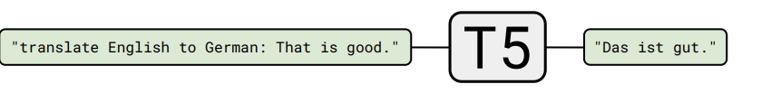
What does this mean in practice?
process & generate next words
Language Model
Notes:
Working definition so far

Slide 41
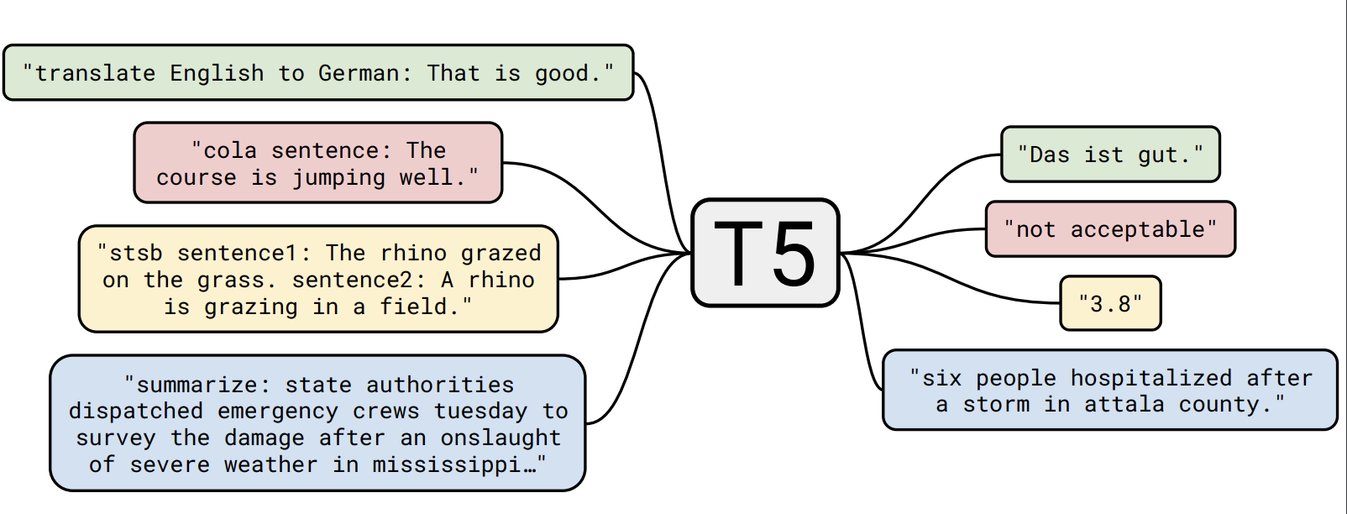
Text-to-text transfer transformer
A unified architecture, treating all tasks as text-to-text tasks (Raffel et al., 2019)
Notes:
Working definition so far

Slide 42
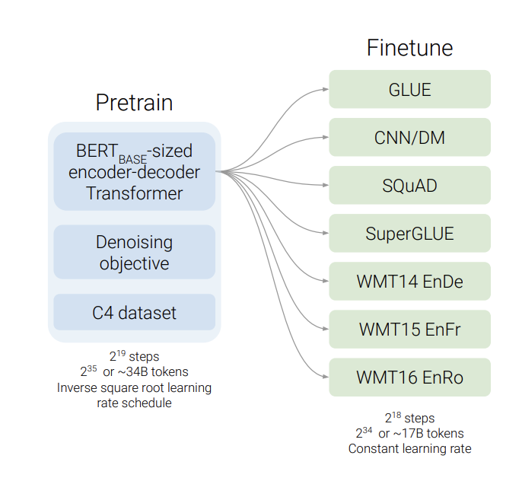
T5: overall logic
Pretrain a model on a version of masked language modeling using a huge corpus (C5)
Fine-tune models individually on each of the tasks, using this “text-to-text” approach, where prompts/instructions are appended to the input (meta-learning, instruction-tuning)
Any performance advantages of this approach over traditional seq-to-seq tasks?
Notes:
Working definition so far

Slide 43

Why this is mindblowing (beyond performance)
You can use the same architecture for any possible task: all you need to change is the prompt!
In the T5 paper, they tune the model individually (with instructions) on each of the target tasks, but you can train the same model on multiple tasks at the same time (multitask learning)
If text-to-text models develop these “meta-learning” skills, i.e., they learn to interpret instructions, they may, in principle, understand instructions for new tasks they have never seen before, without the need for additional training…
Notes:
Working definition so far

Slide 44
Learning without fine-tuning
T5 still assumes that, to perform a task, the model needs to be explicitly fine-tuned on input-output pairs related to that task
This transfer learning paradigm is a common one, but what if we could push this one step further?
What if a model could perform a new task without having been explicitly trained on that task? Is language the key to flexible machine intelligence?
Notes:
Working definition so far

Slide 45
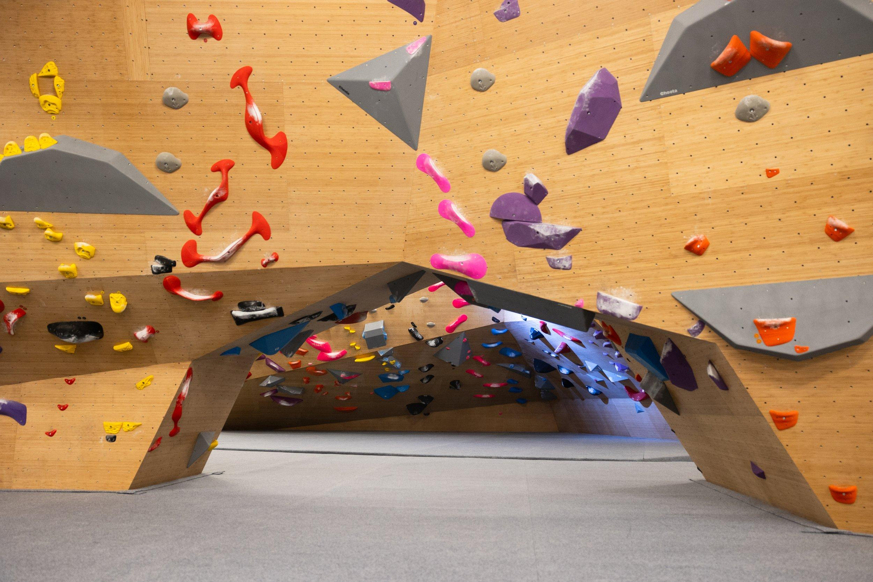
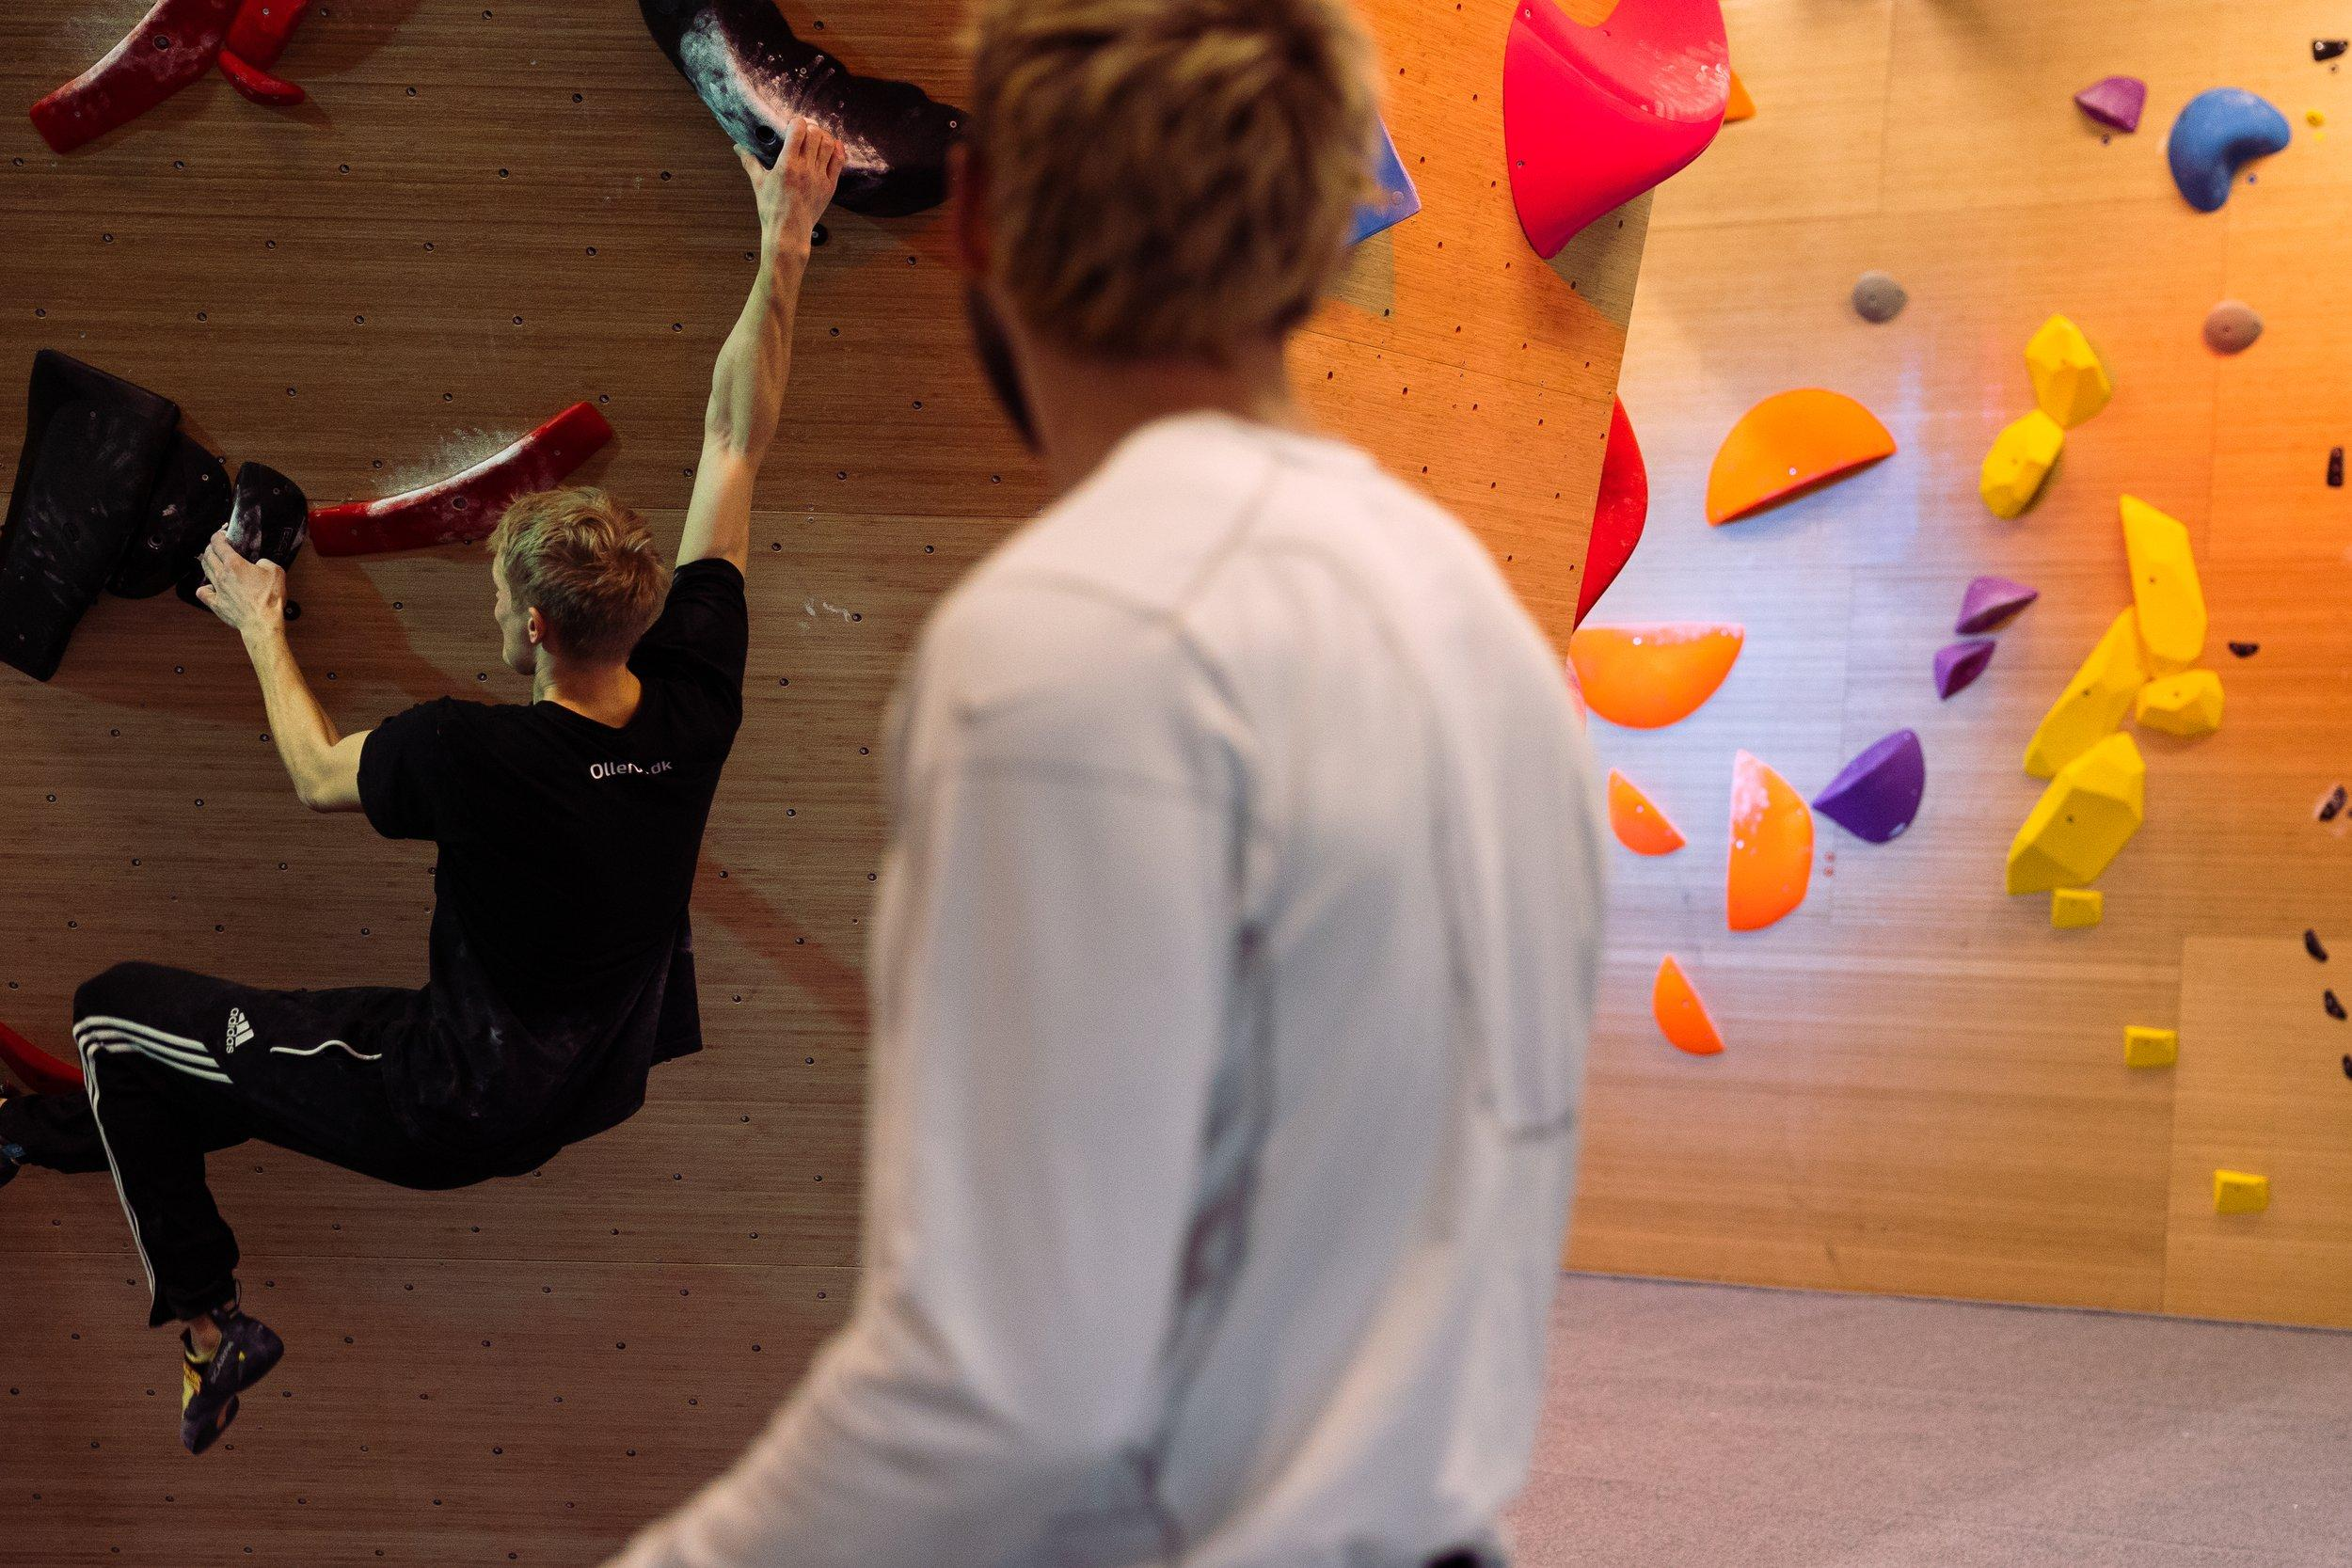
Humans do it all the time
we can transfer more general knowledge from other domains
we can learn by imitation
Notes:
Working definition so far

Slide 46
Few-shot learning: model is passed an input which contains a task description, and a few examples
Learning without fine-tuning/training
Input:
“Sentence: the movie was great. Sentiment: Positive.
Sentence: this restaurant is dark and gloomy.
Sentiment: Negative
Sentence: I love pizza.
Sentiment: ”
We have a task the model has never seen before, e.g, sentiment classification
Notes:
Working definition so far

Slide 47
One-shot learning: model is passed an input which contains a task description, and one example
Learning without fine-tuning/training
Input:
“Sentence: the movie was great. Sentiment: Positive.
Sentence: I love pizza.
Sentiment: ”
We have a task the model has never seen before, e.g, sentiment classification
Notes:
Working definition so far

Slide 48
Zero-shot generalization: model is passed an input with a task description, but no example
Learning without fine-tuning/training
Input:
“Sentence: I love pizza.
Sentiment: ”
We have a task the model has never seen before, e.g, sentiment classification
Notes:
Working definition so far

Slide 49
Often called “in-context” learning
Learning without fine-tuning/training
We have a task the model has never seen before, e.g, sentiment classification
Notes:
Working definition so far

Slide 50
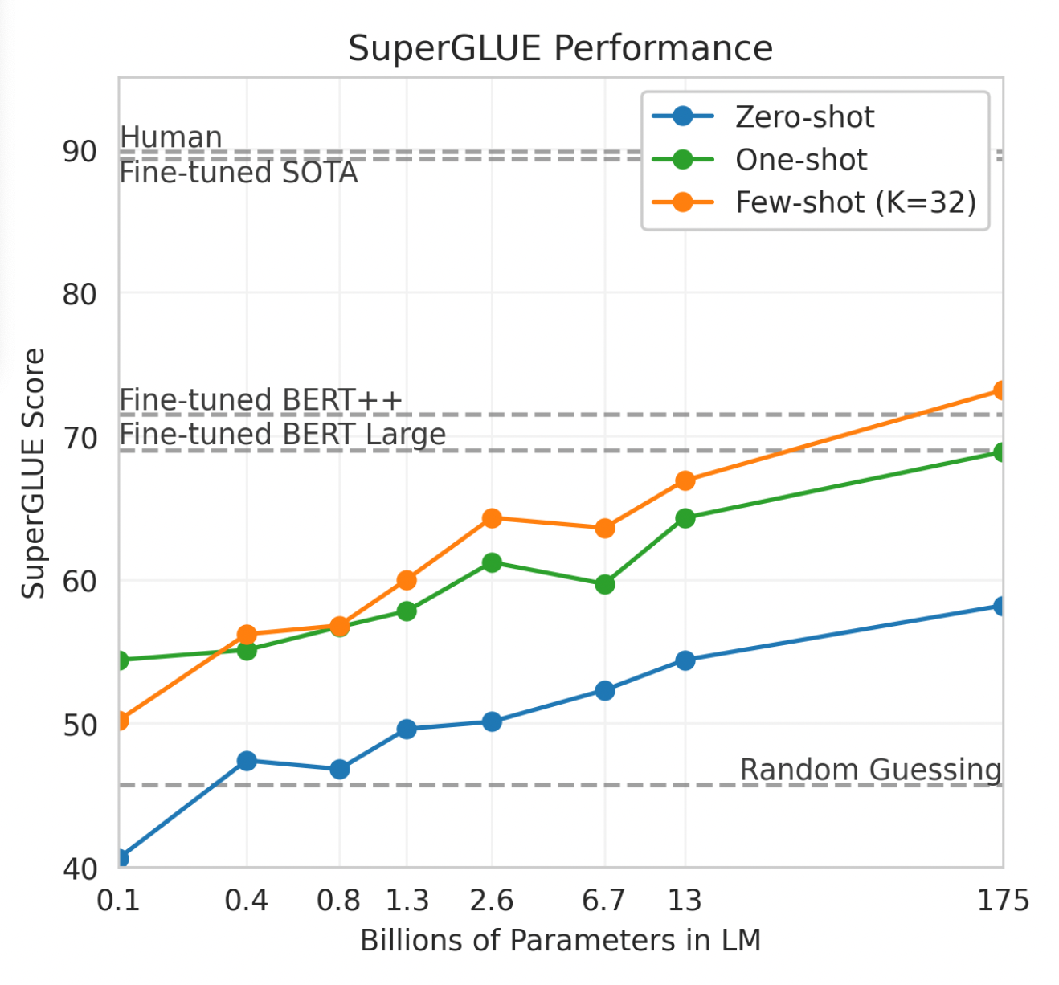
GPT-3: language models are few-shot learners
T5 focuses explores the potential of text-to-text approaches to NLG in the context of a transfer learning paradigm
The GPT-3 tests a different approach to NLG: what if language modeling training at scale was enough to achieve good performance on many NLG tasks?
What if task-specific fine-tuning was not needed at all? What if all we needed was good prompt engineering?
Notes:
Working definition so far

Slide 51
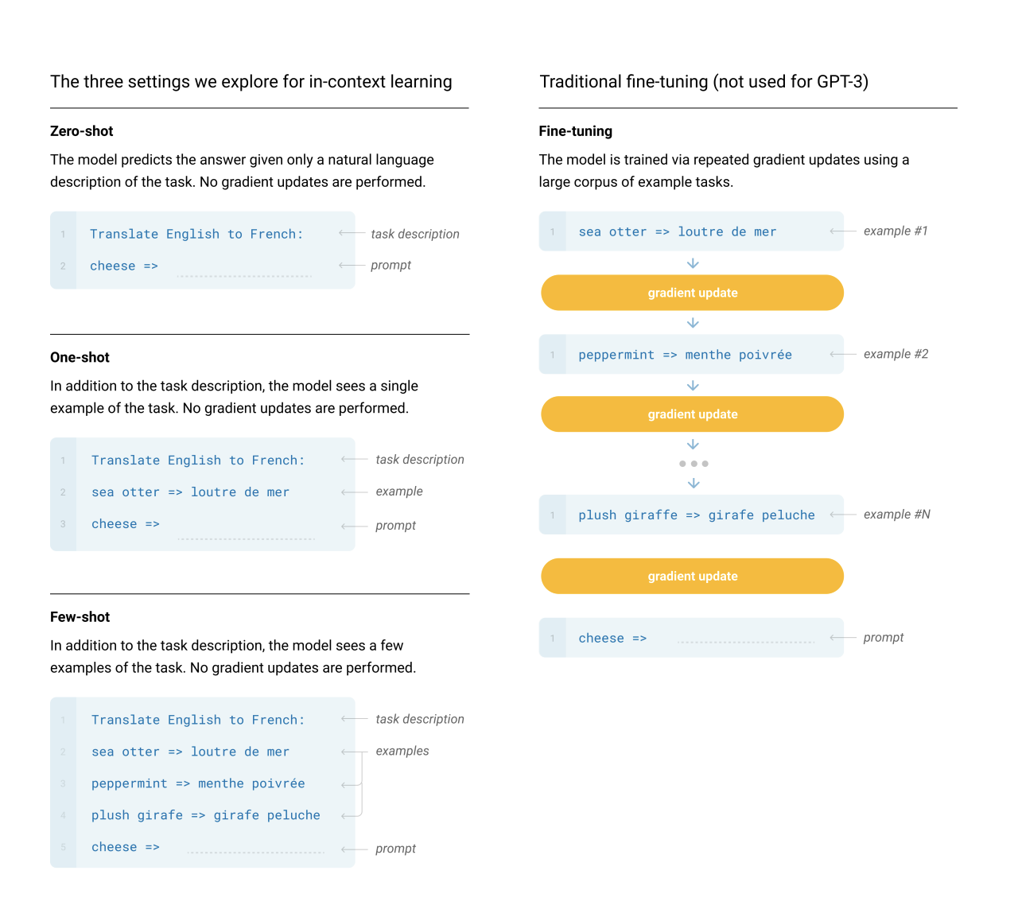

Slide 52
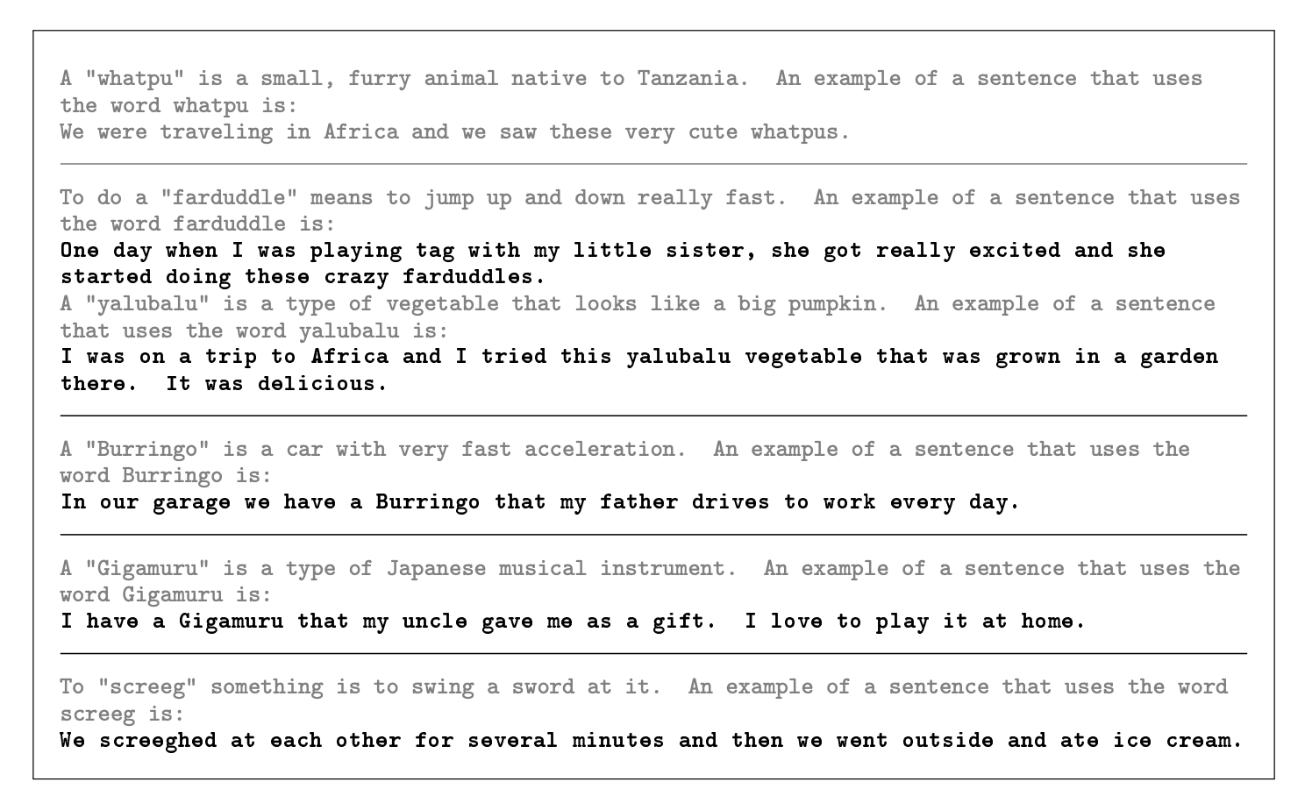

Slide 53
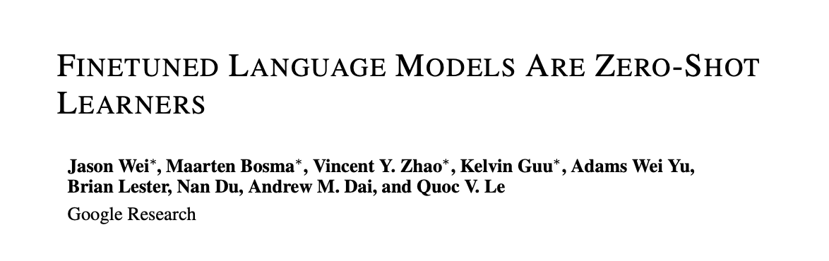
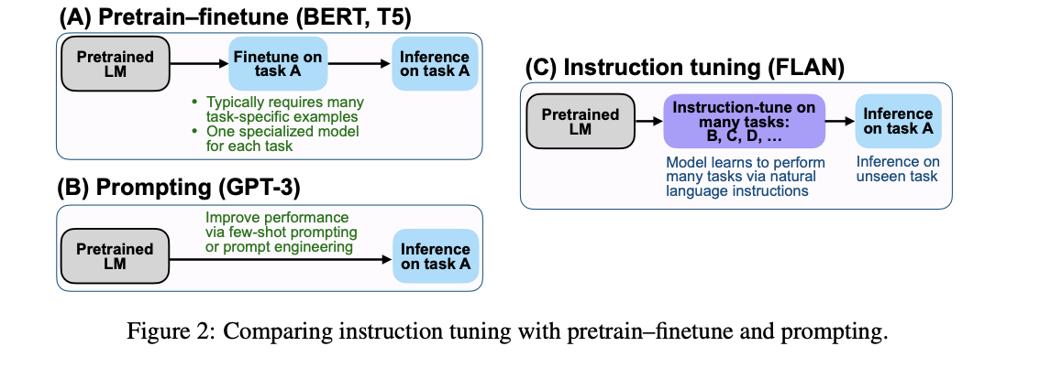
FLAN: instruction-tuned language models are zero-shot learners
Generalizing T5’s logic to multiple tasks, to achieve zero-shot generalization (Wei et al., 2022)
Notes:
Working definition so far

Slide 54
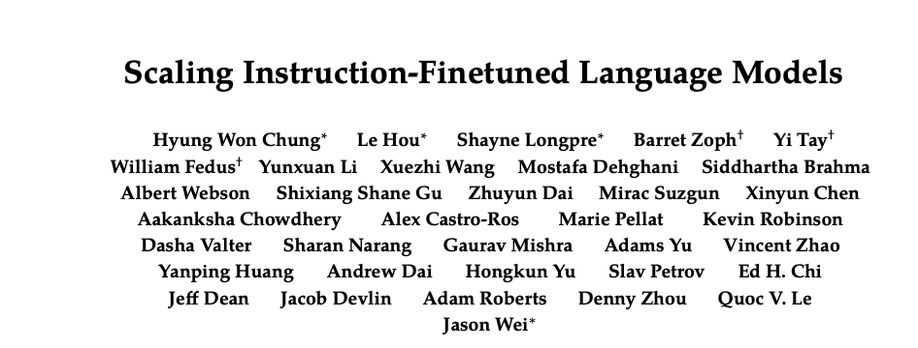
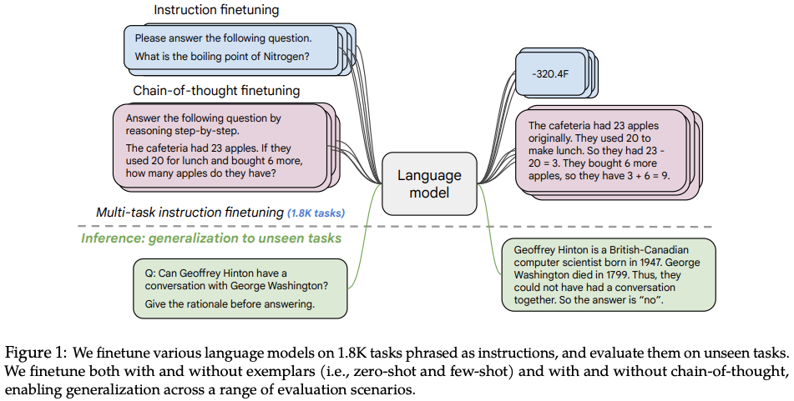
FLAN-T5 (Chung et al., 2022)
Notes:
Working definition so far

Slide 55
Summary
Transformer architectures trained on language modeling can generate language, and they are the backbone of all NLG systems
At training, these models are optimized to producing plausible guesses for the next word through teacher forcing
At inference, text can be produced iteratively through different decoding algorithms
These pretrained models can be used (i.e., the same architecture can be used!) to perform virtually any generative task: all tasks can be thought of as text generation tasks grounded in an input, which contains task instructions
This can be done after fine-tuning (e.g., T5’s approach), or in an in-context fashion (few-, one-, or zero-shot task performance, which seem to emerge with extensive LM training in large architectures)
Notes:
Working definition so far

Slide 56
See you tomorrow!

